Slide 1

Challenges for Large Infrastructures (EOSC, NFDI, Nordic EOSC, etc.)
Peter Wittenburg
Max Planck Computing & Data Facility

Slide 2
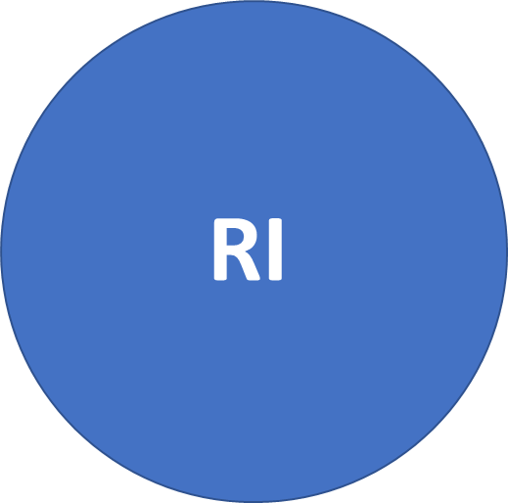

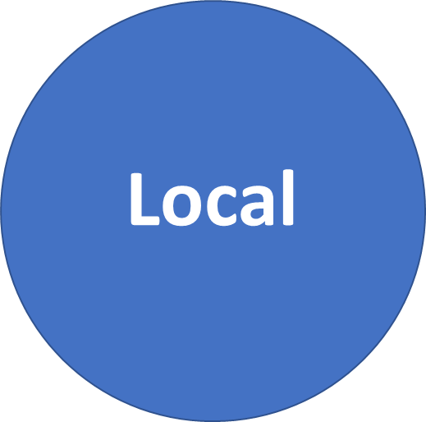

Trend Towards LRI
Individuals?
eInfra
Large RI
DS
1.000s of repositories
10.000s of registries
100.000s of tools/services
all grew up over years
all serving some needs
RO
are LRI (too) complex?
poor Data Scientists are overwhelmed!
no one simple solution to connect!
do we share ambitions (5 y – 100 y)?
do we have a vision for integration?
do DS trust all this and invest?
are LRI just a thin layer or more?

Slide 3
Why this pressure to invest huge sums?
no sustainable digital domain - danger of „dark digital age“ (V. Cerf)
80% of digital data is „dark data“ (P. Heidorn)
~ 95% of data is in labs without certified repositories (my claim)
capability of supporting cutting edge data intensive science and tackling the global challenges
what is the role/relevance of the individual researcher in this big game
? % of funds could be saved if we would be FAIR
30 % of costs in NL healthcare (30 bio € ) due to non-FAIR data (B. Mons)
who has rights to exploit digital data
is data an open good or „controlled“ by GAFA or Publishers
how can we foster innovation by many and create new value-chains

Slide 4
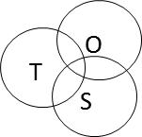
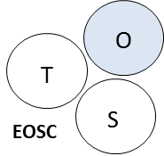
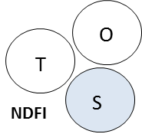
Different Approaches to LRI
Hughes described 3 key factors driving LI as closely related triple:
economic (scientific) perspectives
technological innovation
political/ organisational aspects
EOSC needed to start with governance:
costs much overhead
is decoupled from needs and subject of lobby
can it work – high risk
NFDI (DE) starts with science:
scientists will continue what they did already
is decoupled from technology advancement
can it work – high risk
G. Strawn: Interoperability is good for Science, but bad for
scientists since it costs time.

Slide 5
Technology Driven Activities
learned a lot
educated many people
no abstraction
learning a lot
educating many people
no abstraction
Scientific
Project
Scientific
Project
Scientific
Project
Scientific
Project
Scientific
Project
Scientific
Project
Scientific
Project
Scientific
Project
abstraction
who?
how?
Scientific
Project
abstraction
- virtualisation
- object stores
Scientific
Project
Grid
Movement
Cloud
Movement
?

Slide 6
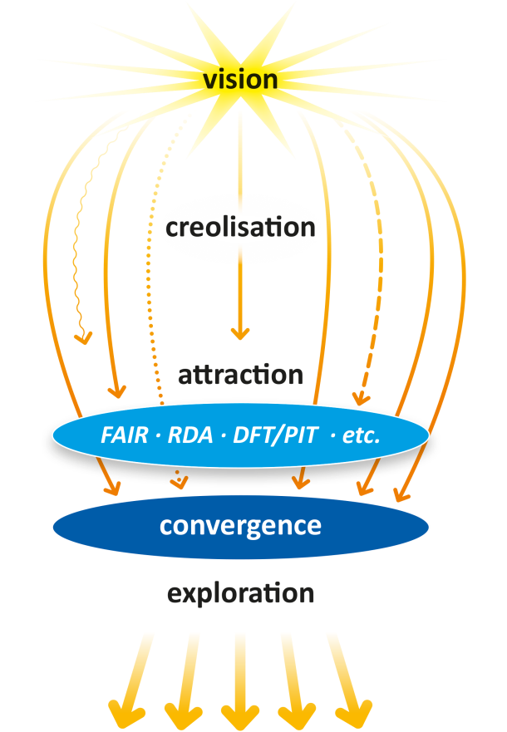
About Convergence
Degree of Complexity is high
Some eternal principles:
reduce complexity by convergence
use the principles of abstraction and encapsulation – this requires stable binding
take care of referential integrity over decades
EOSC, NFDI, etc.
do „we“ share these principals?
do they play a role in the discussions?
my answer is yes & no
FAIR principles are agreed steps to convergence
RDA outputs could be steps – need a message
Turning FAIR into Practice Report: FAIR DOs
but some start with services such as EOSC Portal
Computer Networking
Data Domain
IP
?
Common Patterns in Revolutionary Infrastructures and Data
http://doi.org/10.23728/b2share.4e8ac36c0dd343da81fd9e83e72805a0

Slide 7
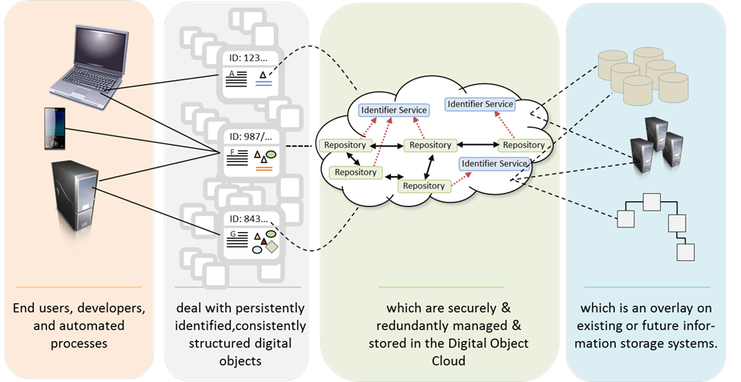
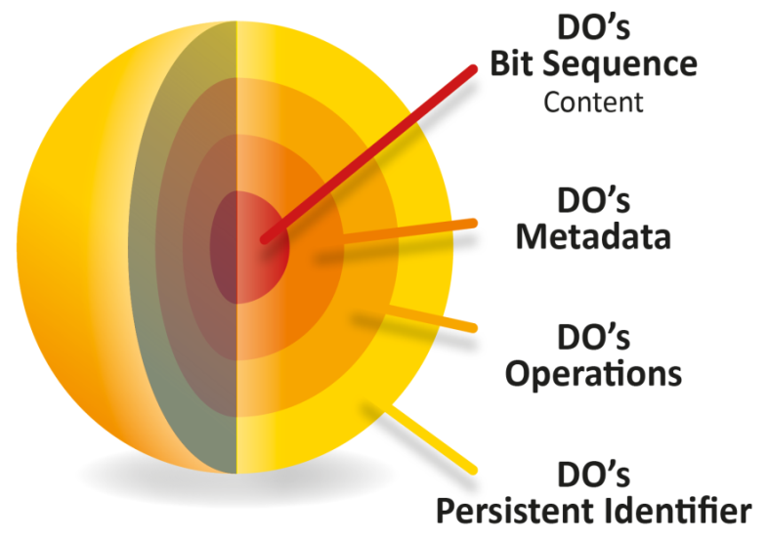
FAIR DOs
copied from Larry Lannom
Embedded in the FAIR DO Concept
abstraction
encapsulation
stable binding
referential integrity over decades is primarily a social matter
is it something for EOSC, NFDI, etc. ?

Slide 8
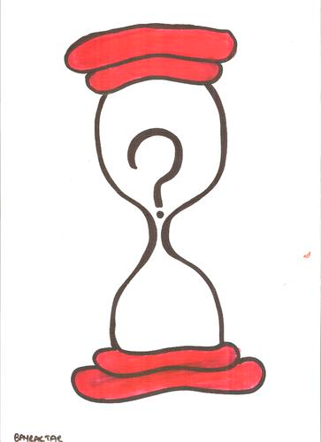
Need Agreed Abstraction Layers
Establishing Large Research Infrastructures is complex, i.e. reducing complexity is key.
LRI need to identify the standards that make up the neck of hourglasses and can act as stable islands in a domain full of dynamics.

Slide 9
EOSC Situation

